Slide 1
AXI DMA Driver Test Instructions
For the Kria KV260 Vision AI Starter Kit

Slide 2
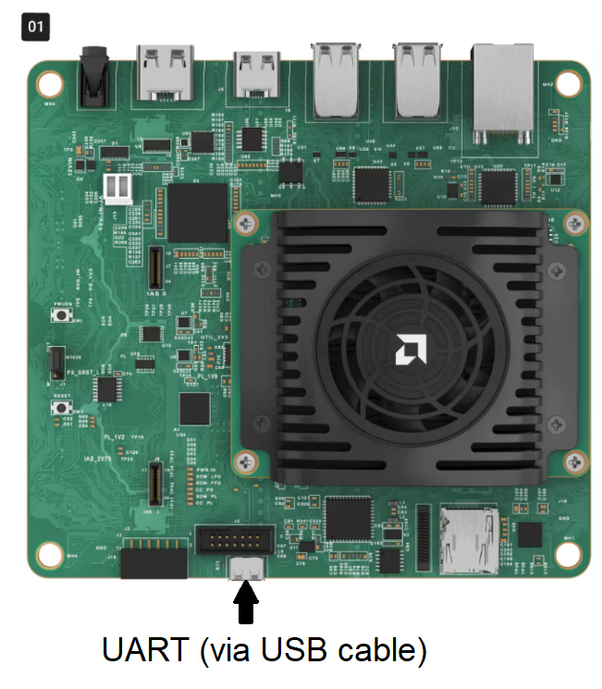
Step 1: Set up
Download the Kria Ubuntu image from the Ubuntu website: https://ubuntu.com/download/amd#kria-k26
Flash the image on a micro SD card with an image flashing tool (e.g. Balena Etcher);
Connect the Kria to your computer via UART
                UART parameters:
                Baud rate = 115200
                Data bits = 8, Stop bits = 1
                Parity = None
                If using PuTTY, remember to change the
                font (in Window -> Appearance)

Slide 3
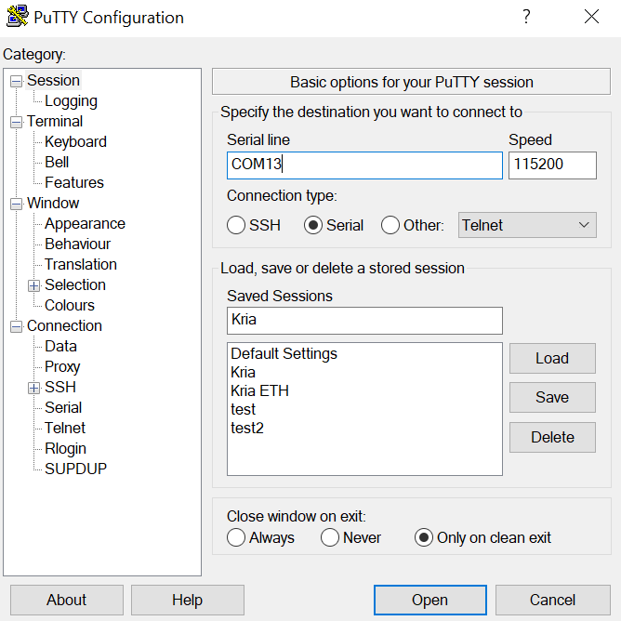
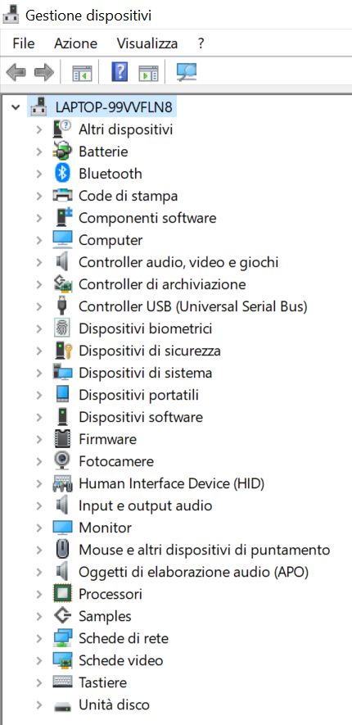
PuTTY
Download PuTTY: https://putty.org/index.html (on ubuntu: sudo apt install putty);
Run it and set up the connection with the parameters shown earlier;
To find the COM port you can go to the Manage Devices tab in the Control Panel (on ubuntu: ls /dev | grep tty OR ls /dev | grep USB)

Slide 4
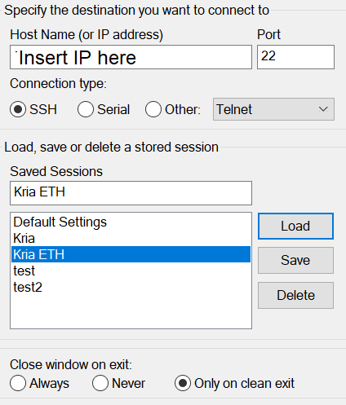
Step 2: Standalone Kria test
Once the PuTTY connection starts up successfully, connect the Kria’s power cable. The PuTTY window should start showing some text;
After the boot up is complete, you will need to set a username and password (recommendation is the same thing for both, forgetting the password is bad!);
Once you’re logged in, it’s strongly recommended to connect the Kria to the internet via ethernet, it will make uploading files to it much less time consuming (good for repeated tests!);
If you connect to the internet, you can find out your IP address via ifconfig;
The Kria’s IP address can be used to connect with PuTTY via Ethernet as well, as it’s a more stable connection than using UART

Slide 5
Step 3: File transfer
To transfer files to your Kria you have two options:
FTP allows you to transfer files quickly but requires the Kria to be connected to the internet and third party software for FTP (e.g. Filezilla);
Manual is much slower, requires a way to work with ext4 file systems (Windows can’t interact with it easily, so it’s recommended to set up a Ubuntu dual boot on your PC if you have Windows) and a micro SD to USB adapter (or any other way to insert the SD into your PC), but it doesn’t require an internet connection.
Using your method of choice, upload the github repository on the Kria (or you can run sudo apt install git and git clone the repo if you have internet access);
Remember to run sudo bash install_libs.sh as well to install all the necessary tools for development

Slide 6
Step 4: Driver test
On the Kria, navigate to the axidma-driver folder;
Run make to compile the driver;
Run sudo insmod axidma.ko to insert the driver into the kernel;
If you run sudo dmesg you should see the driver insertion logs;
Run sudo fpgautil –b aes256_dma.bin to load the bitstream;
Run dtc –i pl.dtsi –o pl.dtbo -@ to compile the device-tree overlay;
Run sudo fpgautil –o pl.dtbo to insert the overlay;
Run sudo dmesg again: you should see that the driver has detected the overlay;
Compile dma_test.c with gcc dma_test.c –o dma_test;
Run the test with ./dma_test
(if your hardware changes you also have to change the device-tree overlay to match it, instructions are in the repository README)

